Slide 1
Linear Models - Classification and Regression
Jen-Ing Hwang
Department of Computer Science and
Information Engineering
Fu Jen Catholic University

Slide 2
Outline
Introduction
Linear Classification
Linear Regression

Slide 3
Introduction (1/2)
Supervised learning 監督式學習
The most popular paradigm for machine learning
Given a dataset with input attribute(s) and output label(s), discovering a relationship between the input and the output
Can be divided into classification and regression problems
Classification(分類): with nominal (名目式) output label(s)
Regression(迴歸): with numeric (數值式) output label(s)

Slide 4
Introduction (2/2)
Linear models
Algorithms searching a hypothesis over the hyperplane(超平面) hypothesis space
Hyperplane
The set of all points that are in R^{M} and satisfy a linear equation
In R², the hyperplanes are straight lines (直線，一維(2-1))
In R³, hyperplanes are planes (平面，二維(3-1))
More generally, if the input instance space is M-dimensional then its hyperplanes are (M-1)-dimensional
超過三度空間之後我們就沒有辦法畫了，所以超過三度空間的我們叫做超平面
狹義的說法：在R4、R5、R6
廣義的說法：在R2、R3、R4 、R5、R6

Slide 5
Outline
Introduction
Linear Classification
Linear Regression

Slide 6
Illustrative Example for Linear Classification
Dataset D
− Students take a class on a Pass/Fail basis
Students | x₁ (Midterm) | x₂ (Final) | y (Pass/Fail)
A | 80 | 60 | +1 (Pass)
B | 50 | 50 | −1 (Fail)
C | 90 | 80 | +1 (Pass)
D | 30 | 60 | −1 (Fail)
E | 40 | 90 | +1 (Pass)
F | 90 | 50 | +1 (Pass)

Slide 7
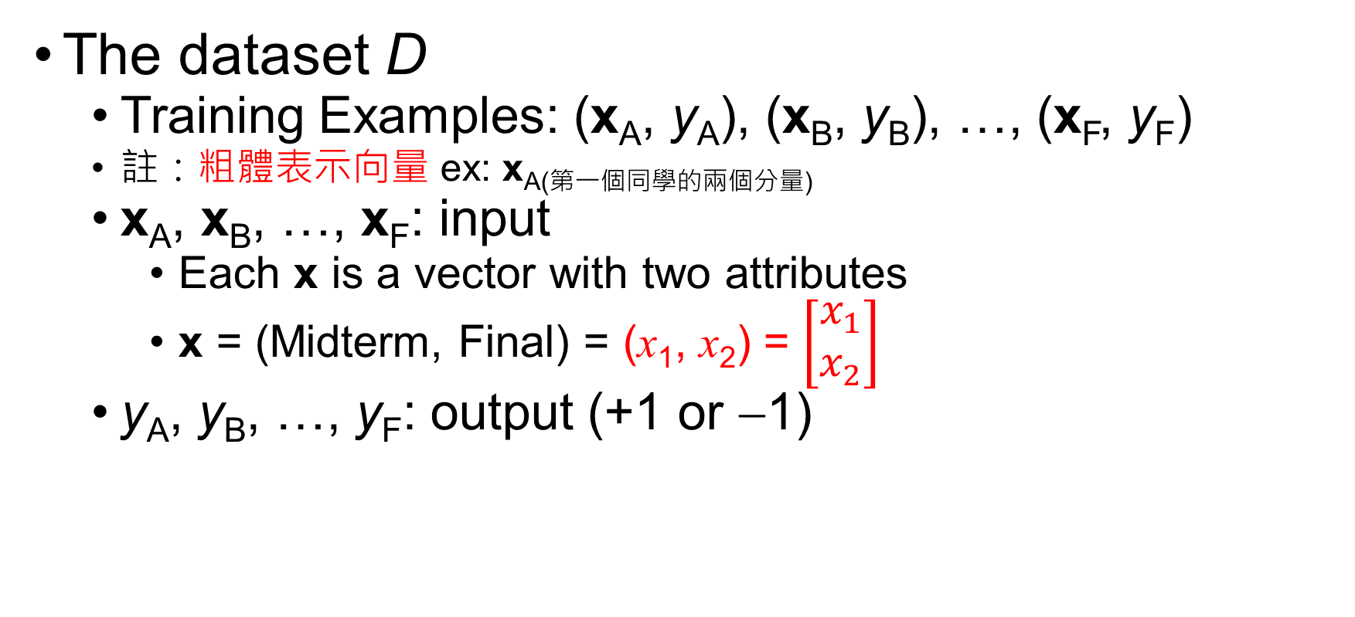
Data Representation
The dataset D
Training Examples: (x_{A}, y_{A}), (x_{B}, y_{B}), …, (x_{F}, y_{F})
註：粗體表示向量 ex: x_{A(第一個同學的兩個分量)}
x_{A}, x_{B}, …, x_{F}: input
Each x is a vector with two attributes
x = (Midterm, Final) = (x₁, x₂) = $\left[\begin{matrix}x_{1} \\ x_{2}\end{matrix}\right]$
y_{A}, y_{B}, …, y_{F}: output (+1 or −1)

Slide 8
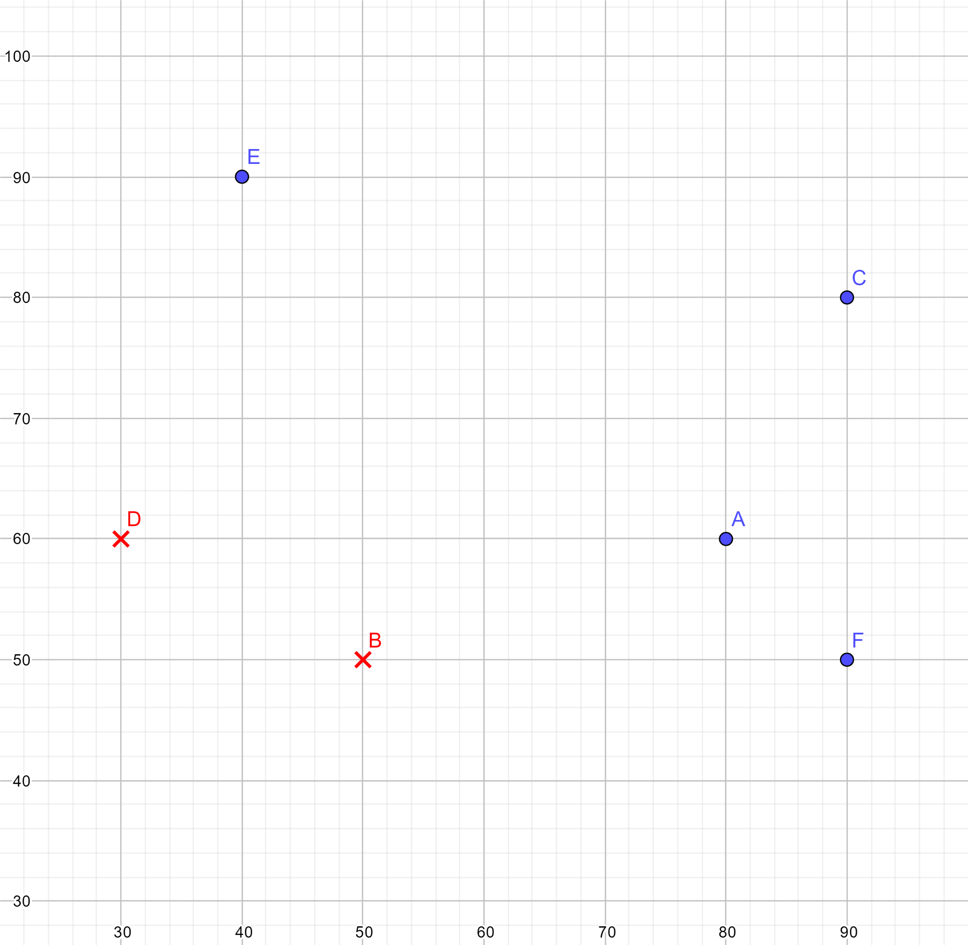
Hypothesis Space and Version Space
Hypothesis Space (假說空間) H = The set of straight lines
<註> 所有的假說形成的集合。是我認為一條直線可以把它分開，但是這條直線可能可以分開，可能不能分開，對於那些可以分開的我們叫它Version Space
Version Space VS_{H,D} =
{All straight lines that separate positive and negative examples.}
註記： Version Space並不唯一
->如果點(data)越多，能找到正確的直線的可能性就變高了
We can apply the Perceptron Learning Algorithm (PLA) to find a consistent hypothesis(一致假設)

Slide 9
Perceptron Learning Algorithm (PLA) (1/2) 透過不斷的內積、修正錯誤，進而找到一條可以將資料分成兩類的演算法
For input x = (x₁, x₂) //grades of a students
Pass if w₁ x₁ + w₂ x₂ > threshold
((w₁ x₁ + w₂ x₂)− threshold) > 0
Fail if w₁ x₁ + w₂ x₂ < threshold
((w₁ x₁ + w₂ x₂)− threshold) < 0
This linear formula h ∈ H can be written as
h (x) = sign ((w₁ x₁ + w₂ x₂) − threshold)

Slide 10
Perceptron Learning Algorithm (PLA) (2/2)
h(x) = sign ((w₁ x₁ + w₂ x₂) − threshold)
Let w₀ = − threshold
⇒ h(x) = sign ((w₁ x₁ + w₂ x₂) + w₀ )
Introduce an artificial coordinate x₀ = 1 (杜撰的，為了讓式子變好看，可以讓它寫成內積)
⇒ h(x) = sign (w₀ x₀ + w₁ x₁ + w₂ x₂ )
We can write h(x) in vector form:
h (x) = sign (w•x) // • inner product
where w = (w₀, w₁, w₂) and x = (x₀, x₁, x₂) // x₀ = 1

Slide 11
What PLA Does? (1/4)
Given the training examples: (x_{A}, y_{A}), (x_{B}, y_{B}), …, (x_{F}, y_{F})
if an input example, x_{k}, is misclassified (它該+1時，你算出來是-1，它該是-1時，你算出來是+1)
(i.e., sign (w• x_{k}) ≠ y_{k} , k ∈ {A, B, …, F})
then update the weight vector w
w ← w + y_{k}x_{k} // Note that y_{k} is +1 or −1

Slide 12
What PLA Does? (2/4)
Two misclassified types for a training example (x, y)
Type 1: (答案應是1，我算出來的卻是-1)
y = 1 (正解) but h(x) = sign (w₀ x₀ + w₁ x₁ + w₂ x₂) = −1 (x_{0 、} x_{1 、} x_{2和}w_{0、} w_{1 、} w₂在平面的兩側)
⇒ PLA: w ← w + yx
⇒ PLA: w ← w + 1x // make w close to x
W想成是法向量
w：Normal vector of the line
x ：The training example
w+1x ： Normal vector of the new line
w_{0、} w_{1 、} w_{2代表}R_{3空間的平面的法向量}
x_{0 、} x_{1 、} x_{2代表}R_{3空間的任何一個點，只是有一個虛擬的}x_{0的X軸=1，所以我所有的}x0都是在1這個地方，但可以假想成自從引入了這個虛擬的X軸以後，好像data是在R_{3空間}
_{請問}x_{0 、} x_{1 、} x_{2和}w_{0、} w_{1 、} w_{2的內積是多少？}
_{若>0，表示W跟X是在同一個法向量的平面上}
_{若<0，表示W跟X是在法向量的另外兩側}
y = 1
w+1x
x
w
New Line
y = 1
我希望x_{0 、} x_{1 、} x_{2和}w_{0、} w_{1 、} w₂在同一面

Slide 13
What PLA Does? (3/4)
y = 1
PLA:
w ← w + 1x // make w close to x
Old Line
w+1x
x
w：Normal vector of the line
x：The training example
w+1x：Normal vector of the new line
(怎麼加? Ans:平行四邊形的對角線)
w
New Line

Slide 14
What PLA Does? (4/4)
Type 2: (答案是-1，你卻算出來是+1，表示其實你的X應該要跟法向量是另外一邊)
y = −1 but h(x) = sign (w₀ x₀ + w₁ x₁ + w₂ x₂) = 1
⇒ PLA: w ← w + yx
⇒ PLA: w ← w + (−1)x // move w away from x
y = −1
w：Normal vector of the line
x ： The training example
w+(−1)x ： Normal vector of the new line
w
x
w+(−1)x
−x
New Line

Slide 15
The PLA Algorithm
Epoch：scan所有的data一次
Given training dataset:
D = {(x₁, y₁), …, (x_{N}, y_{N})} // N training examples
Initialize all weights w_{i} to random values
// w = (w₀, w₁, …, w_{M}); M+1 attributes
WHILE not all examples correctly predicted DO
FOR each training example xk ∈ D
If sign (w• xk) ≠ yk then w ← w + yk xk
Note: The PLA is guaranteed to converge if the training set is linearly separable.

Slide 16
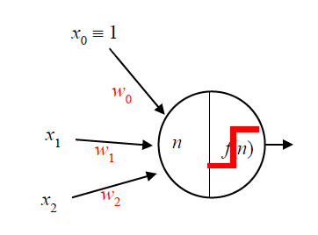
Perceptron Architecture
Net input: n = w₀ x₀ + w₁x₁ + w₂x₂
Activation Function:
f(n) = sign (n)
Two different outputs
Binary Classification

Slide 17
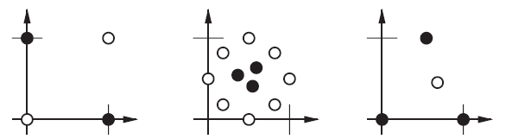
Remarks on PLA (1/2)
The decision boundary is always orthogonal (正交的) to the weight vector.
Single-layer perceptrons can only classify linearly separable inputs(只能分類可線性分離的資料們).
The PLA cannot solve linearly inseparable problems.
Examples of linearly inseparable problems:

Slide 18

Remarks on PLA (2/2)
Variants of PLA:
Activation Function: a = $f\left(n\right)=\left\{\begin{matrix}0 if n <0 \\ 1 if n ≥0\end{matrix}\right.$
w ← w + e x; e = (y – a)

Slide 19
Outline
Introduction
Linear Classification
Linear Regression

Slide 20
Illustrative Example for Linear Regression
Simple Linear Regression:
Finding a relationship between two continuous variables; x and y = f(x)
Data points of Price (= y) vs. House size (= x) for sale in Berkeley, CA, in July 2009, along with the linear regression that minimizes squared error: ŷ = 0.232x + 246.
Figure adapted from Fig 18.13 in Ref. [1]

Slide 21
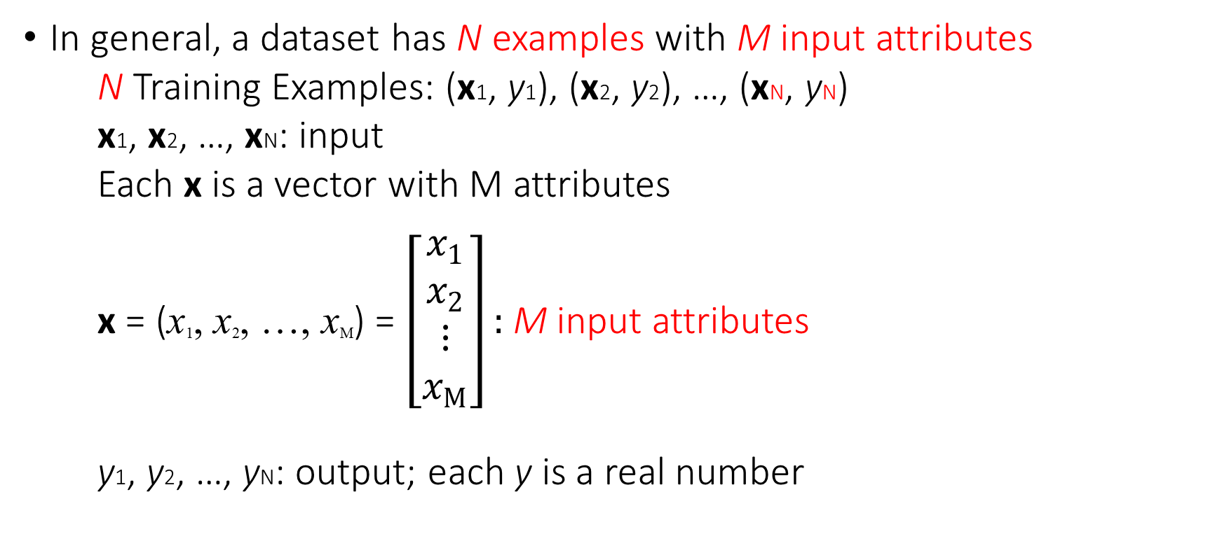
Data Representation
In general, a dataset has N examples with M input attributes
N Training Examples: (x1, y1), (x2, y2), …, (xN, yN)
x1, x2, …, xN: input
Each x is a vector with M attributes
x = (x₁, x₂, …, x_{M}) = $\left[\begin{matrix}x_{1} \\ x_{2} \\ ⋮ \\ x_{M}\end{matrix}\right]:$M input attributes
y1, y2, …, yN: output; each y is a real number

Slide 22
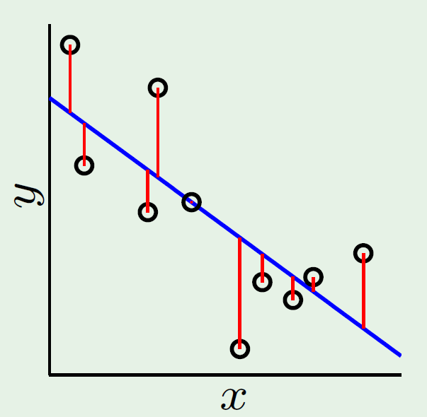
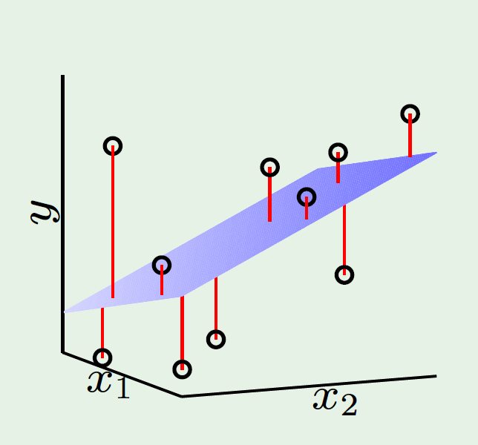
Illustration of Linear Regression
10 (= N) training examples
1 (= M) attribute; x
10 (= N) training examples
2 (= M) attributes; x1, x2
Figures adapted from Fig 3.3 in Ref. [2]

Slide 23
How to Measure the Error? (1/2)
How well does a hypothesis function h(x) approximate the target function f(x)?
In linear regression, we can measure the accuracy of our hypothesis function using an error function (又稱 cost function or loss function).
One common measure:
the squared error (h(x) − f(x))²

Slide 24
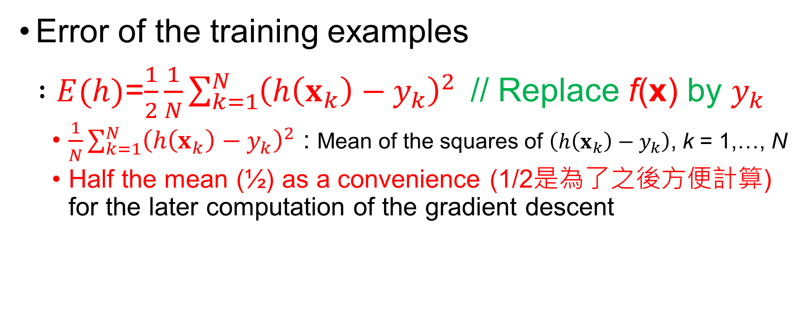
How to Measure the Error? (2/2)
Error of the training examples
$:E(h)$=$\frac{1}{2}\frac{1}{N}\sum_{k=1}^{N}{{\left(h\left(x_{k}\right)−y_{k}\right)}^{2}}$// Replace f(x) by $y_{k}$
$\frac{1}{N}\sum_{k=1}^{N}{{\left(h\left(x_{k}\right)−y_{k}\right)}^{2}}$ : Mean of the squares of $\left(h\left(x_{k}\right)−y_{k}\right)$, k = 1,…, N
Half the mean (½) as a convenience (1/2是為了之後方便計算) for the later computation of the gradient descent

Slide 25
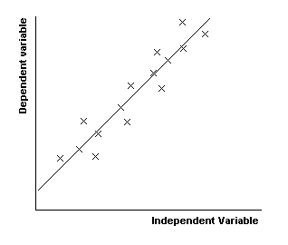
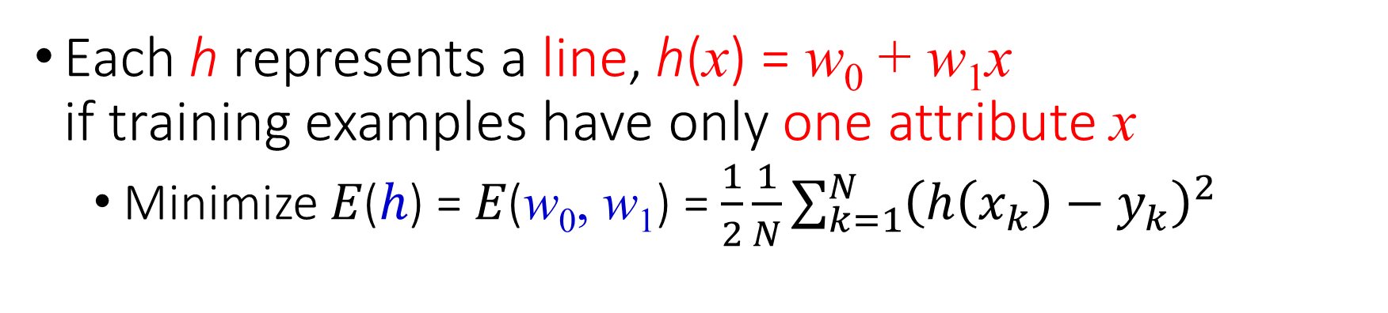
Minimizing Error Function
Each h represents a line, h(x) = w₀ + w₁x if training examples have only one attribute x
Minimize 𝐸(ℎ) = 𝐸(w₀, w₁) = $\frac{1}{2}\frac{1}{N}\sum_{k=1}^{N}{{\left(h\left(x_{k}\right)−y_{k}\right)}^{2}}$
y
h₃
Note: h(x) = w₀ + w₁x
w₀: y-intercept
w₁: the slope of line
h₂
h₁
x

Slide 26
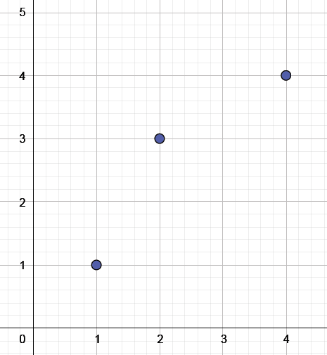
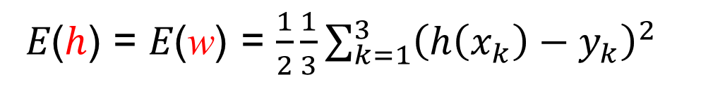
Error Function – one weight (1/5)
Assume that w₀ = 0 通過原點
// A line pass through the origin h(x) = w₀ + w₁x = w₁x
⇒ h(x) = wx // Let w₁ = w for the sake of simplicity(為了簡單)
Training examples (x, y):
(1, 1), (2, 3), (4, 4)
𝐸(ℎ) = 𝐸(w) = $\frac{1}{2}\frac{1}{3}\sum_{k=1}^{3}{{\left(h\left(x_{k}\right)−y_{k}\right)}^{2}}$

Slide 27
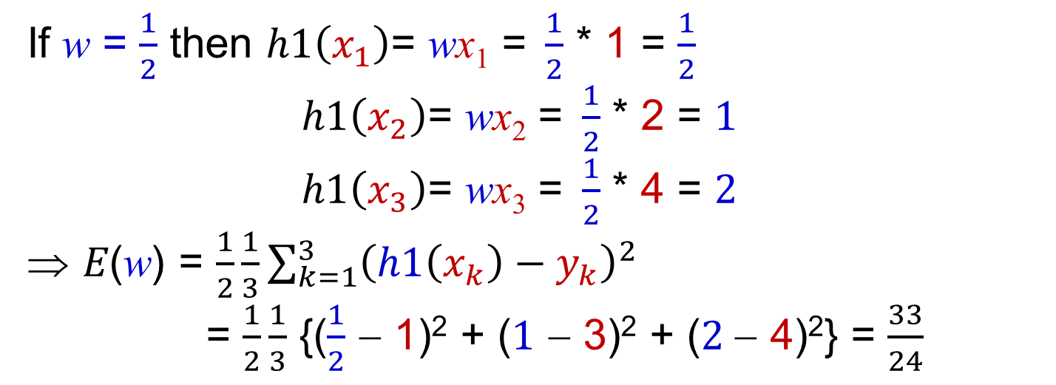
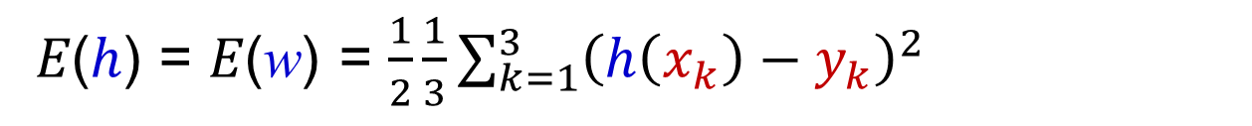
Error Function – one weight (2/5)
Training examples: (x₁, y₁) = (1, 1); (x₂, y₂) = (2, 3); (x₃, y₃) = (4, 4)
𝐸(ℎ) = 𝐸(w) = $\frac{1}{2}\frac{1}{3}\sum_{k=1}^{3}{{\left(h\left(x_{k}\right)−y_{k}\right)}^{2}}$
If w = $\frac{1}{2}$ then $h1\left(x_{1}\right)\text{=} \text{w}\text{x}\text{1} \text{=} \frac{1}{2}$ * 1 = $\frac{1}{2}$
$h1\left(x_{2}\right)\text{=} \text{w}\text{x}\text{2} \text{=} \frac{1}{2}$ * 2 = $1$
$h1\left(x_{3}\right)\text{=} \text{w}\text{x}\text{3} \text{=} \frac{1}{2}$ * 4 = $2$
𝐸(w) = $\frac{1}{2}\frac{1}{3}\sum_{k=1}^{3}{{\left(h1\left(x_{k}\right)−y_{k}\right)}^{2}}$
= $\frac{1}{2}\frac{1}{3}$ {($\frac{1}{2}$ − 1)² + ($1$ − 3)² + ($2$− 4)²} = $\frac{33}{24}$

Slide 28
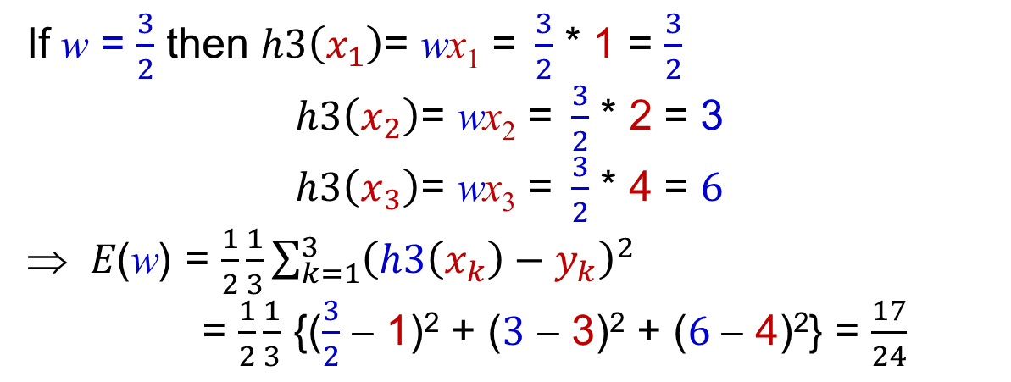
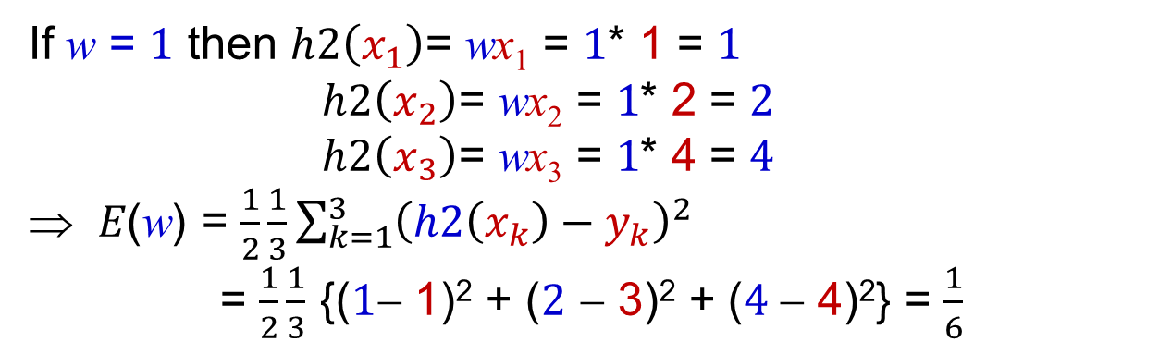
Error Function – one weight (3/5)
If w = $1$ then $h2\left(x_{1}\right)\text{=} \text{w}\text{x}\text{1} \text{=} 1$* 1 = $1$
$h2\left(x_{2}\right)\text{=} \text{w}\text{x}\text{2} \text{=} 1$* 2 = $2$
$h2\left(x_{3}\right)\text{=} \text{w}\text{x}\text{3} \text{=} 1$* 4 = $4$
𝐸(w) = $\frac{1}{2}\frac{1}{3}\sum_{k=1}^{3}{{\left(h2\left(x_{k}\right)−y_{k}\right)}^{2}}$
= $\frac{1}{2}\frac{1}{3}$ {($1$− 1)² + ($2$ − 3)² + ($4$− 4)²} = $\frac{1}{6}$
If w = $\frac{3}{2}$ then $h3\left(x_{1}\right)\text{=} \text{w}\text{x}\text{1} \text{=} \frac{3}{2}$ * 1 = $\frac{3}{2}$
$h3\left(x_{2}\right)\text{=} \text{w}\text{x}\text{2} \text{=} \frac{3}{2}$ * 2 = 3
$h3\left(x_{3}\right)\text{=} \text{w}\text{x}\text{3} \text{=} \frac{3}{2}$ * 4 = $6$
𝐸(w) = $\frac{1}{2}\frac{1}{3}\sum_{k=1}^{3}{{\left(h3\left(x_{k}\right)−y_{k}\right)}^{2}}$
= $\frac{1}{2}\frac{1}{3}$ {($\frac{3}{2}$ − 1)² + ($3$ − 3)² + ($6$− 4)²} = $\frac{17}{24}$

Slide 29
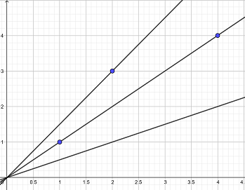
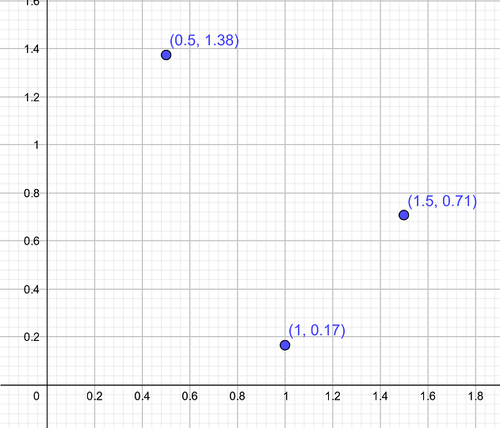
Error Function – one weight (4/5)
E(h1)= E(w) E(0.5)=33/24
h₃: w = 1.5
y
E(w)
h₂: w = 1
E(h3)=E(w)= E(1.5)=17/24
h₁: w = 0.5
E(h2)=E(w)=
E(1)=1/6
x
w
Data points and
different hypotheses
Error Function: 𝐸(w)

Slide 30

Error Function – one weight (5/5)
Gradient = $\frac{dE(w)}{dw}$
Initial Weight
E(w)
Minimum
w
Note: When w is a scalar, the gradient(梯度) is the tangent line.

Slide 31
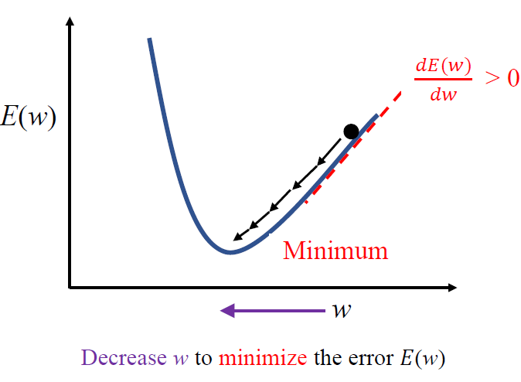
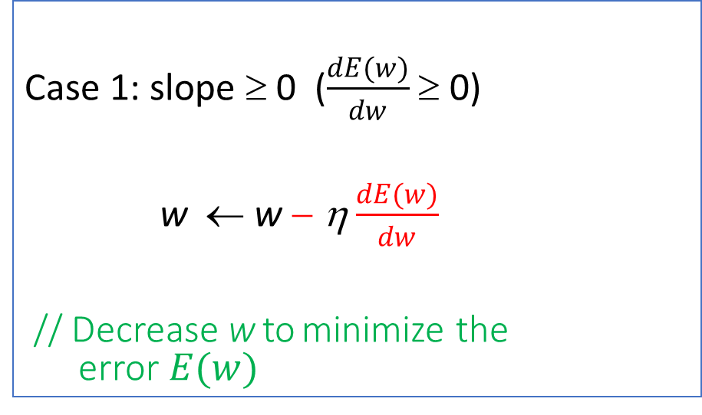
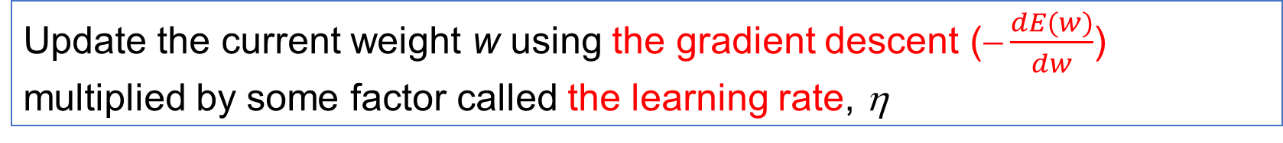
Gradient Descent – one weight (1/5)
Update the current weight w using the gradient descent ($\frac{dE(w)}{dw}$) multiplied by some factor called the learning rate, η
Case 1: slope ≥ 0 ($\frac{dE(w)}{dw}$ ≥ 0)
w ← w − η$\frac{dE(w)}{dw}$
// Decrease w to minimize the error $E(w)$
Positive

Slide 32
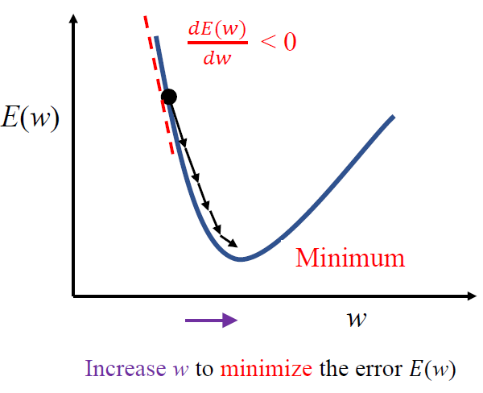
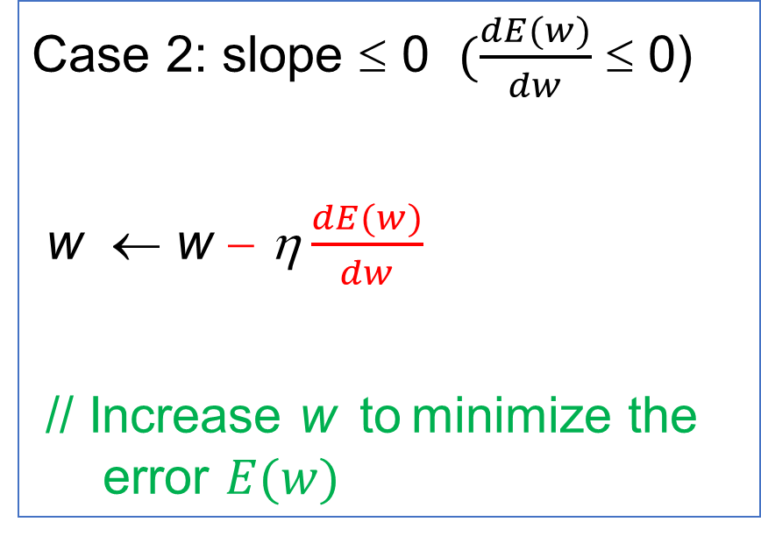
Gradient Descent – one weight (2/5)
這個error function要往Minimum的方向走的話，一定都是跟它的微分的負方向有關
Case 2: slope ≤ 0 $(\frac{dE(w)}{dw}$ ≤ 0)
w ← w − η$\frac{dE(w)}{dw}$
// Increase w to minimize the error $E(w)$
Negative

Slide 33
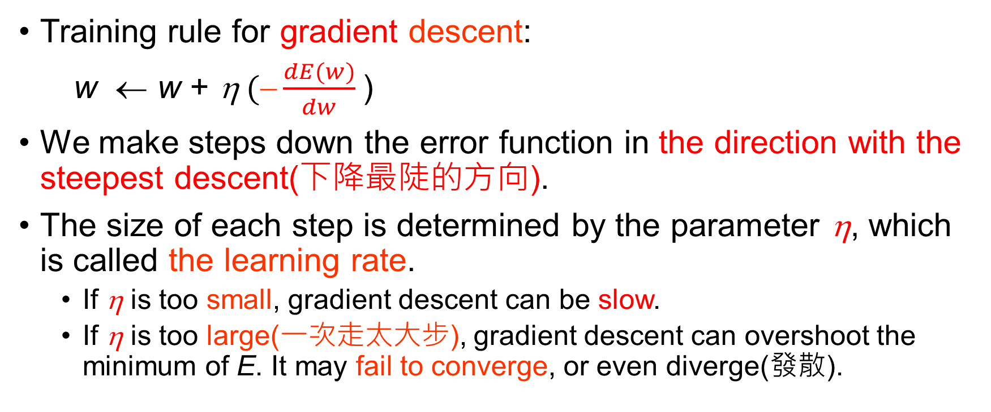
Gradient Descent – one weight (3/5)
Training rule for gradient descent:
w ← w + η$(\frac{dE(w)}{dw}$)
We make steps down the error function in the direction with the steepest descent(下降最陡的方向).
The size of each step is determined by the parameter η, which is called the learning rate.
If η is too small, gradient descent can be slow.
If η is too large(一次走太大步), gradient descent can overshoot the minimum of E. It may fail to converge, or even diverge(發散).

Slide 34
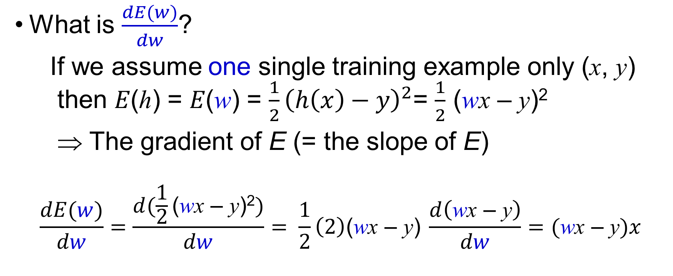
Gradient Descent – one weight (4/5)
What is $\frac{dE(w)}{dw}$?
If we assume one single training example only (x, y) then 𝐸(ℎ) = 𝐸(w) = $\frac{1}{2}{\left(h\left(x\right)−y\right)}^{2}$= $\frac{1}{2}$ (wx – y)²
⇒ The gradient of E (= the slope of E)
$$\frac{dE(w)}{dw}=\frac{d(\frac{1}{2}\text{(}\text{w}\text{x}\text{ – }\text{y}\text{)}\text{2})}{dw}= \frac{1}{2}\left(2\right)\text{(}\text{w}\text{x}\text{ – }\text{y}\text{)} \frac{d\left(\text{w}\text{x}\text{ – }\text{y}\right)}{dw}=(\text{w}\text{x}\text{ – }\text{y})x$$
乘上1/2是為了讓式子變好看

Slide 35

Gradient Descent – one weight (5/5)
Training rule for gradient descent:
w ← w + η$(\frac{dE(w)}{dw}$)
⇒ w ← w + η$((\text{wx}\text{ – }\text{y})x$)
⇒ w ← w + η$\left(y–\text{w}x\right)x$
Learning Rate
Input
(Output Label − Estimated Output)

Slide 36
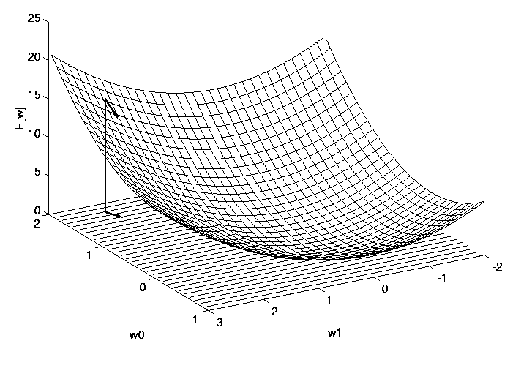
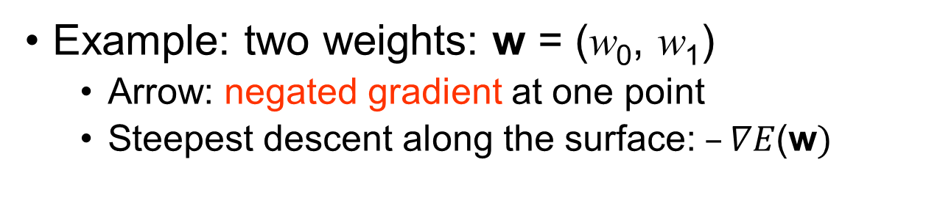
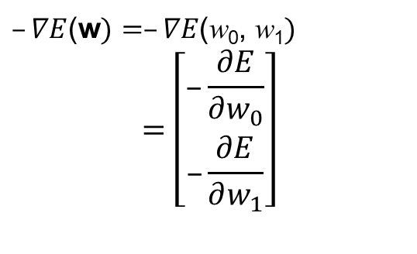
Error Function - two weights
Example: two weights: w = (w₀, w₁)
Arrow: negated gradient at one point
Steepest descent along the surface:$–∇E$(w$)$
$–∇E$(w$)=–∇E\text{(}\text{w}\text{0}\text{,} \text{w}\text{1})$
$$=\left[\begin{matrix}–\frac{∂E}{∂w_{0}} \\ –\frac{∂E}{∂w_{1}}\end{matrix}\right]$$
Figure adapted from Fig 4.4 in Ref. [3]

Slide 37
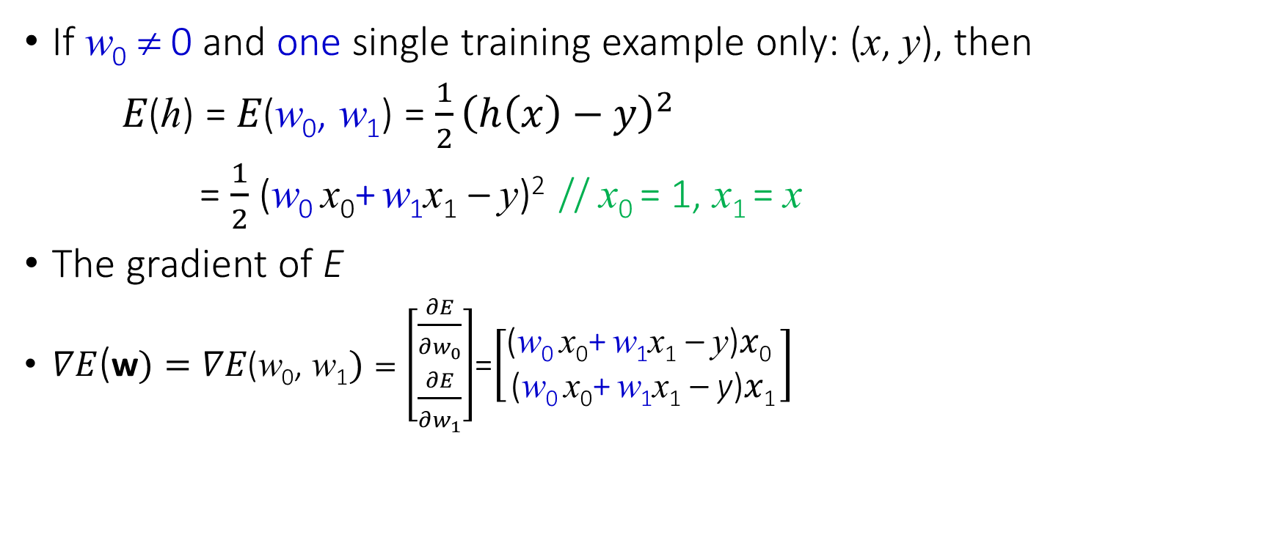
Gradient Descent – two weights (1/2)
If w₀ ≠ 0 and one single training example only: (x, y), then
𝐸(ℎ) = 𝐸(w₀, w₁) = $\frac{1}{2}{\left(h\left(x\right)−y\right)}^{2}$
= $\frac{1}{2}$ (w₀ x₀+ w₁x₁ – y)² // x₀ = 1, x₁ = x
The gradient of E
$∇E$(w$)=∇E\text{(}\text{w}\text{0}\text{,} \text{w}\text{1})=\left[\begin{matrix}\frac{∂E}{∂w_{0}} \\ \frac{∂E}{∂w_{1}}\end{matrix}\right]$=$\left[\begin{matrix}\text{(}\text{w}\text{0 }\text{x}\text{0}\text{+} \text{w}\text{1}\text{x}\text{1}\text{ – }\text{y}\text{)}x\text{0} \\ \text{(}\text{w}\text{0 }\text{x}\text{0}\text{+} \text{w}\text{1}\text{x}\text{1}\text{ – }\text{y}\text{)}x\text{1}\end{matrix}\right]$

Slide 38
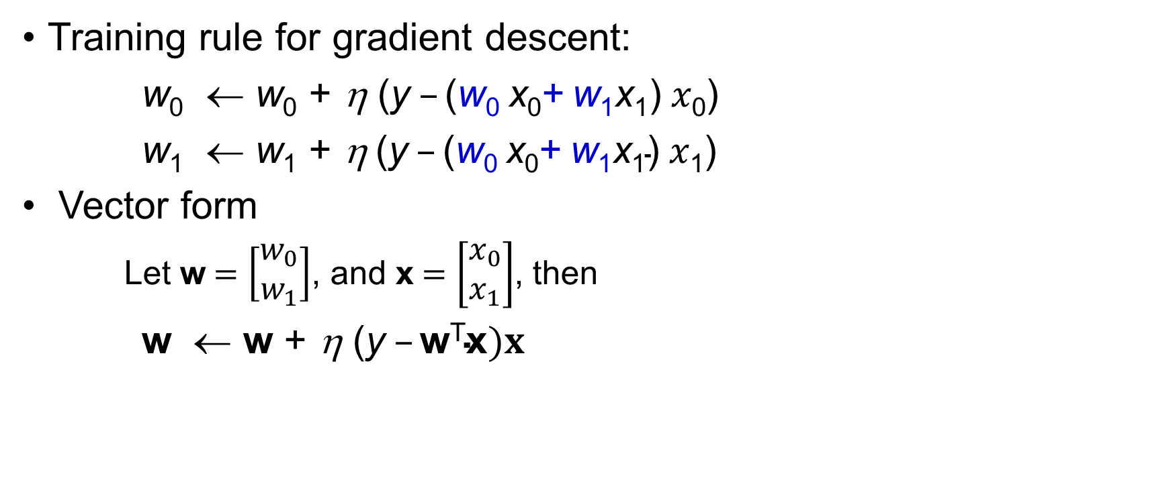
Gradient Descent – two weights (2/2)
Training rule for gradient descent:
w₀ ← w₀ + η $\text{(}\text{y} –\text{(}\text{w}\text{0 }\text{x}\text{0}\text{+} \text{w}\text{1}\text{x}\text{1}\text{)} x\text{0}$)
w₁ ← w₁ + η$\text{(}\text{y} –\text{(}\text{w}\text{0 }\text{x}\text{0}\text{+} \text{w}\text{1}\text{x}\text{1}\text{)} x\text{1}$)
Vector form
Let w$=\left[\begin{matrix}w_{0} \\ w_{1}\end{matrix}\right]$, and x$=\left[\begin{matrix}x_{0} \\ x_{1}\end{matrix}\right]$, then
w ← w + η $\text{(}\text{y} –\text{w}\text{T}\text{x})x$
Learning Rate
Input
(Output Label − Estimated Output)

Slide 39
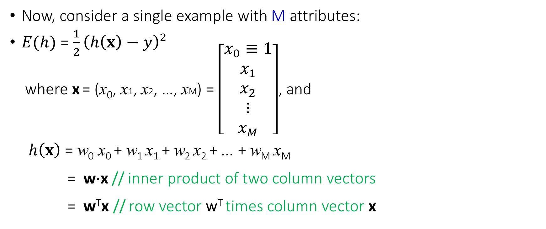
Error Function – (M+1) weights (1/2)
Now, consider a single example with M attributes:
$E(h)$ = $\frac{1}{2}{\left(h\left(x\right)−y\right)}^{2}$
where x = (x₀, x1, x2, …, xM) = $\left[\begin{matrix}x_{0}≡1 \\ x_{1} \\ x_{2} \\ ⋮ \\ x_{M}\end{matrix}\right]$, and
$h\left(x\right)$ = w₀ x₀ + w₁ x₁ + w₂ x₂ + ... + w_{M} x_{M}
= w⋅x // inner product of two column vectors
= w^{T}x // row vector w^{T} times column vector x

Slide 40
Error Function– (M+1) weights (2/2)
w = (w₀, w₁, w₂, w₃, ..., w_{M}) is to be determined and to be fit in the learning problem.
The space H of candidate hypothesis is the set of all possible real-valued weight vectors:
H = {w|w ∈ R^{M+1}}

Slide 41
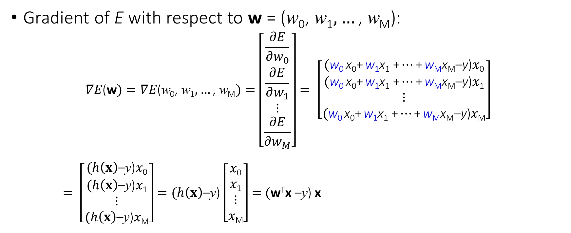
Gradient Descent – (M+1) weights (1/2)
Gradient of E with respect to w = ($\text{w}\text{0}\text{,} \text{w}\text{1},…\text{,} \text{w}\text{M}$):
$$∇E\text{(}\text{w})=∇E\text{(}\text{w}\text{0}\text{,} \text{w}\text{1},…\text{,} \text{w}\text{M})=\left[\begin{matrix}\frac{∂E}{∂w_{0}} \\ \frac{∂E}{∂w_{1}} \\ ⋮ \\ \frac{∂E}{∂w_{M}}\end{matrix}\right]= \left[\begin{matrix}\text{(}\text{w}\text{0 }\text{x}\text{0}\text{+} \text{w}\text{1}\text{x}\text{1}\text{ +}…\text{+} \text{w}\text{M}\text{x}\text{M}\text{–}\text{y}\text{)}x\text{0} \\ \text{(}\text{w}\text{0 }\text{x}\text{0}\text{+} \text{w}\text{1}\text{x}\text{1}\text{ +}…\text{+} \text{w}\text{M}\text{x}\text{M}\text{–}\text{y}\text{)}x\text{1} \\ ⋮ \\ \text{(}\text{w}\text{0 }\text{x}\text{0}\text{+} \text{w}\text{1}\text{x}\text{1}\text{ +}…\text{+} \text{w}\text{M}\text{x}\text{M}\text{–}\text{y}\text{)}x\text{M}\end{matrix}\right]$$
$= \left[\begin{matrix}\text{(}h\left(x\right)\text{–}\text{y}\text{)}x\text{0} \\ \text{(}h\left(x\right)\text{–}\text{y}\text{)}x\text{1} \\ ⋮ \\ \text{(}h\left(x\right)\text{–}\text{y}\text{)}x\text{M}\end{matrix}\right]=\text{(}h\left(x\right)\text{–}\text{y}\text{)}\left[\begin{matrix}x\text{0} \\ x\text{1} \\ ⋮ \\ x\text{M}\end{matrix}\right]$ $=$ $\text{(}\text{w}\text{T}\text{x} \text{–}\text{y}\text{)}$ x

Slide 42
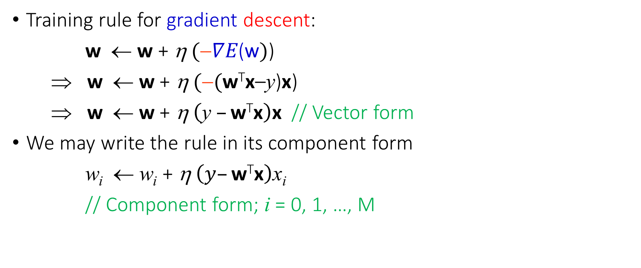
Gradient Descent – (M+1) weights (2/2)
Training rule for gradient descent:
w ← w + η$(∇E\text{(}\text{w})$)
⇒ w ← w + η$(\text{(}\text{w}\text{T}\text{x}\text{–}\text{y}\text{)}\text{x}\text{)}$
⇒ w ← w + η$\left(\text{y} –\text{w}\text{T}\text{x}\right)\text{x}$ // Vector form
We may write the rule in its component form
w_{i} ← w_{i} + η$\left(y–\text{w}\text{T}\text{x}\right)$x_{i}
// Component form; i = 0, 1, …, M

Slide 43
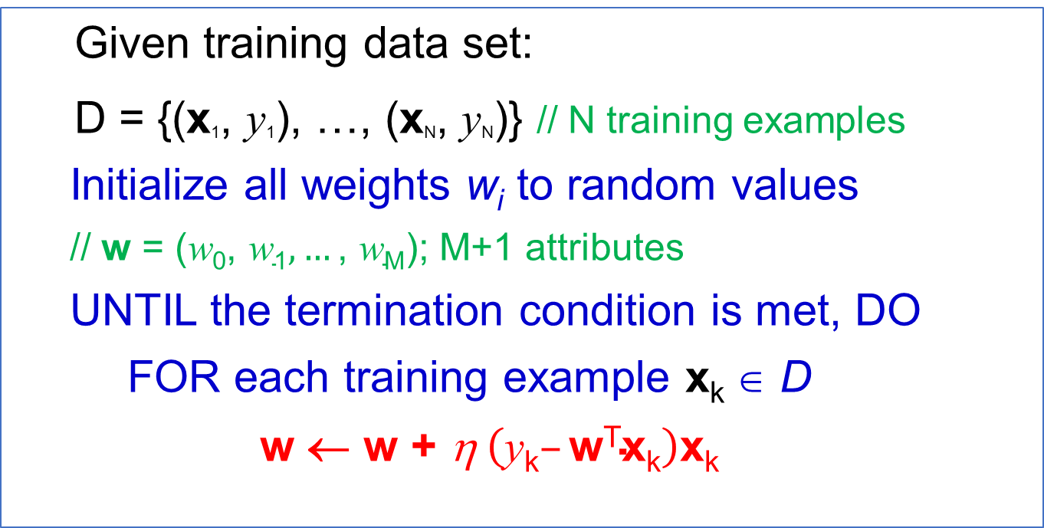
The Gradient Descent Algorithm
Given training data set:
D = {(x₁, y₁), …, (x_{N}, y_{N})} // N training examples
Initialize all weights w_{i} to random values
// w = ($\text{w}\text{0}\text{,} \text{w}\text{1},…\text{,} \text{w}\text{M}$); M+1 attributes
UNTIL the termination condition is met, DO
FOR each training example x_{k} ∈ D
w ← w + η$\left(\text{y}\text{k}–\text{w}\text{T}\text{x}\text{k}\right)$x_{k}

Slide 44
Remarks on the Gradient Descent Algorithm (1/2)
The gradient descent algorithm is also known as 又稱為
Delta rule
ADALINE rule
Widrow-Hoff rule
The gradient descent algorithm is used in regression(迴歸) problems whose training data have an infinite(無限) number of outputs.
Regression: with numeric output label(s) ⇒ an infinite number of values
However, it can also be used in classification(分類) problems whose training data have a finite(有限) number of outputs.
Classification: with nominal output label(s) ⇒ a finite number of values

Slide 45
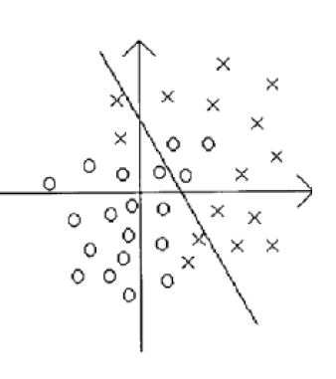
Remarks on the Gradient Descent Algorithm (2/2)
When we use the gradient descent algorithm to solve a classification problem, it converges toward a best-fit(最適合的) approximation to the target concept If the training examples are not linearly separable(不可線性分離).

Slide 46
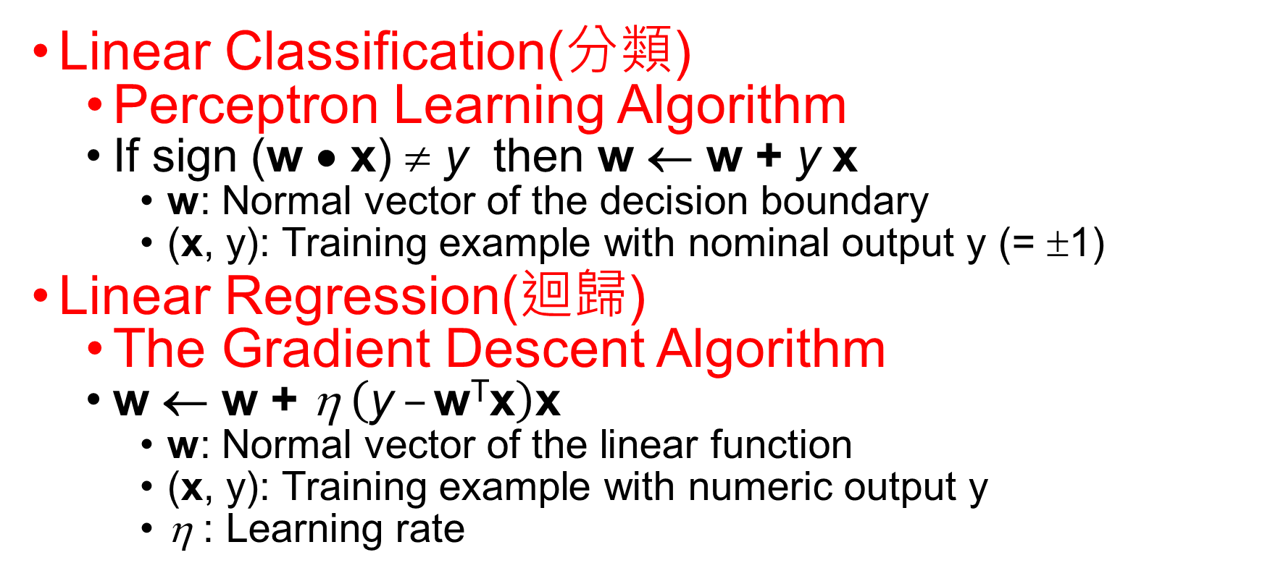
Summary
Linear Classification(分類)
Perceptron Learning Algorithm
If sign (w • x) ≠ y then w ← w + y x
w: Normal vector of the decision boundary
(x, y): Training example with nominal output y (= ±1)
Linear Regression(迴歸)
The Gradient Descent Algorithm
w ← w + η$\left(\text{y} –\text{w}\text{T}\text{x}\right)$x
w: Normal vector of the linear function
(x, y): Training example with numeric output y
η : Learning rate

Slide 47
Kahoot
(T)1. A one-neuron perceptron can classify two classes of objects.
(F) 2. The average squared difference between classifier predicted output and actual output is the Mean Absolute Error.
(T) 3. The goal of the gradient descent is to minimize a given loss function of the neural network.
(F) 4. Gradient descent always converges to some global minimum.
(T) 5. The “learning rate” is the step size that is the amount the weights are updated during training.

Slide 48
(F) 6. In batch gradient descent, we consider one example at a time to update the current weight and bias values.
(F) 7. Logistic regression is mainly used for regression. (It is popularly used for classification.)
(T) 8. The cost function for logistic regression is the Cross-Entropy.
(T) 9. Logistic regression predicts the probability of the occurrence of a binary outcome.
(F) 10. Logistic regression transforms its output using the tanh function to return a probability value.(tanh function(+1 ~ -1)只能視為是Logistic regression的變形

Slide 49
References
[1] Artificial Intelligence: A Modern Approach, Third edition, Stuart Russell and Peter Norvig, Prentice Hall Series in Artificial Intelligence, 2010.
[2] Learning from Data, Yaser S. Abu-Mostafa, Malik Magdon-Ismail, and Hsuan-Tien Lin, AMLBook, 2012.
[3] Machine Learning, Tom M. Mitchell, McGraw-Hill, 1997.

